Slide 1
Coding Bootcamp 3
Web Design and Development Fundamentals (Front End)
Lesson 2
(Common)
Notes:
https://codeandwork.github.io/courses/

Slide 2
JavaScript Part I
4.6.1 Code in JavaScript, variables, functions
4.6.2 Code using advance java script: if conditions, loops

Slide 3
Contents
Introduction to JavaScript
Client-Side Scripting
Language Syntax
Variables
Strings
Numbers
Booleans
Operators
Conditionals
Loops
Arrays
Objects

Slide 4
Learning Objectives
Learn the basics of JavaScript
Familiarize yourself with the syntax of JavaScript
Understand the basic usage of JavaScript
Practice on the fundamental concepts and features of the language
Code in JavaScript using variables, functions
Learn how arrays are used in JavaScript
Understand conditionals, loops
Familiarize with JavaScript Objects

Slide 5
Syllabus
4.6 Javascript/ Jquery | 4.6.1 | Code in JavaScript, variables, functions
 | 4.6.2 | Code using advance java script: if conditions, loops
 | 4.6.3 | Improve usability of forms, validate data from the user

Slide 6
What is JavaScript? (1)
Introduced by Netscape back in 1996
A lightweight, interpreted, programming language
Runs inside the browser
Object-oriented and prototype-based rather than class-based as the other OOP languages such as C++, Java and C#

Slide 7
What is JavaScript? (2)
JS is a prototype-based, multi-paradigm, dynamic scripting language
It is known as the scripting language for Web pages
It is used in non-browser environments also, like Νode.js and CouchDB
developer.mozilla.org/en-US/docs/Web/JavaScript

Slide 8
What can we do with JavaScript?
Develop interactive web applications
Develop server-side applications
Interact with my database (e.g. CouchDB)
You can RUN JavaScript:
In the browser
On the server

Slide 9
JavaScript At First Glance
JavaScript is the programming language of HTML and the Web.
Easy To Use
Can change HTML Content (Attributes, Elements
Can change HTML Styles (CSS)
Is Case Sensitive
Uses the Unicode character set
In HTML, JavaScript code must be inserted between <script> and </script> tags
<script>
document.getElementById(“demo”).innerHTML = “My First JavaScript”;
</script>
Scripts can be placed in the <body>, or in the <head> section of an HTML page, or in both.

Slide 10
JavaScript features
It can be used to create
sophisticated desktop-like applications that run within the browser
mobile applications
browsers’ extensions
It is becoming the language of the Internet of Things
There are plenty of JavaScript frameworks, libraries and plug-ins

Slide 11
Client-Side Scripting (1)
There are many advantages of client-side scripting:
Processing can be offloaded from the server to client machines, thereby reducing the load on the server
The browser can respond more rapidly to user events than a request to a remote server ever could, which improves the user experience
JavaScript can interact with the downloaded HTML in a way that the server cannot, creating a user experience more like desktop software than simple HTML ever could

Slide 12
Client-Side Scripting (2)
The disadvantages of client-side scripting are mostly related to how programmers use JavaScript in their applications
There is no guarantee that the client has JavaScript enabled
The differences between various browsers and operating systems make it difficult to test for all potential client configurations
What works in one browser, may generate an error in another
JavaScript-heavy web applications can be complicated to debug and maintain

Slide 13
How JavaScript works?
Web Browser
1. GET /mypage.html
4. Web browser can
layout & display the
page to the user
2. mypage.html
3. Execute any
JavaScript
required

Slide 14

JavaScript Example

Slide 15
Class Exercise #1
Write your own first JavaScript code snippet, using your own name and age.
Save as myFirst.js

Slide 16
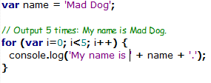
JavaScript Syntax
JavaScript uses a C-like syntax, like Java and C#.

Slide 17
Class Exercise #2
Write your own JavaScript code snippet, like the one below
Save as mySecond.js

Slide 18
Variables
Variables are symbolic names for values in your application.
Variables are declared with the var keyword (e.g. var n = 5;).
Variables in JavaScript are dynamically typed.
Meaning a variable can be an integer, and then later a string, then later an object, if so desired
This simplifies variable declarations, so that we do not require the familiar type fields like int, char, and String
Instead we use var
Assignment can happen at declaration-time by appending the value to the declaration, or at run time with a simple right-to-left assignment

Slide 19
Variables naming
All JavaScript variables must be identified with unique names
These unique names are called identifiers
General rules:
can contain letters, digits, underscores, and dollar signs
must begin with a letter
can also begin with $ and _
are case sensitive
reserved words (like JavaScript keywords) cannot be used as names
Examples of legal names are Number_hits, temp99, $credit, and _name.

Slide 20
Declaring Variables
You can declare a variable in three ways:
With the keyword var. Example: var x = 42. This syntax can be used to declare both local and global variables.
By simply assigning it a value. Example, x = 42. This always declares a global variable, if it is declared outside of any function. It generates a strict JavaScript warning. You shouldn't use this variant.
With the keyword let. Example, let y = 13. This syntax can be used to declare a block-scope local variable.

Slide 21
Variables examples
each line should be terminated by semicolon
var abc;
var def=0;
def= 4;
def= “hello”;
a variable named def initialized with 0
notice that the type of the value assigned to def
has changed to string without any special
instruction or declaration

Slide 22
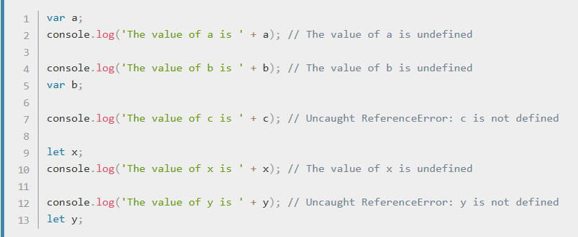
Evaluating Variables (1)
A variable declared using the var or let statement with no assigned value specified has the value of undefined.
An attempt to access an undeclared variable will result in a ReferenceError exception being thrown:

Slide 23
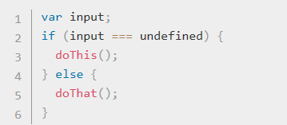
Evaluating Variables (2)
You can use undefined to determine whether a variable has a value.
In the following code, the variable input is not assigned a value, and the if statement evaluates to true.

Slide 24
Evaluating Variables (3)
Also note that:
The undefined value behaves as false when used in a boolean context.
The undefined value converts to NaN when used in numeric context.
When you evaluate a null variable, the null value behaves as 0 in numeric contexts and as false in boolean contexts.

Slide 25
Class Discussion
Consider the following code snippets:
var n; console.log('The value of n is ' + n);
n = 11; console.log('The value of n is ' + n);
What is the value of n in these cases?

Slide 26
Class Discussion – Answer
Consider the following code:
var n; console.log('The value of n is ' + n);
//The value of n is undefined
n = 11; console.log('The value of n is ' + n);
//The value of n is 11

Slide 27
Class Discussion
Consider the following code snippets:
var myArray = [];
if (!myArray[0]) myFunction();
var n = null;
console.log(n * 32);
What will happen in these cases?

Slide 28
Class Discussion - Answer
Consider the following code snippets:
var myArray = [];
if (!myArray[0]) myFunction();
The function myFunction will be executed as myArray is undefined.
var n = null;
console.log(n * 32);
Will log 0 to the console (behave as 0 in numeric context)

Slide 29
Variable Scope
When you declare a variable outside of any function, it is called a global variable, because it is available to any other code in the current document.
When you declare a variable within a function, it is called a local variable, because it is available only within that function.
JavaScript before ECMAScript 2015 does not have block statement scope; rather, a variable declared within a block is local to the function (or global scope) that the block resides within.

Slide 30
Global Variables
Global variables are in fact properties of the global object.
In web pages the global object is window, so you can set and access global variables using the window.variable syntax.
Consequently, you can access global variables declared in one window or frame from another window or frame by specifying the window or frame name.
For example, if a variable called phoneNumber is declared in a document, you can refer to this variable from an iframe as parent.phoneNumber.

Slide 31
Constants
You can create a read-only, named constant with the const keyword. The syntax of a constant identifier is the same as for a variable identifier: it must start with a letter, underscore or dollar sign ($) and can contain alphabetic, numeric, or underscore characters.
Example: const PI = 3.14;
A constant cannot change value through assignment or be re-declared while the script is running. It has to be initialized to a value.
The scope rules for constants are the same as those for let block-scope variables.
If the const keyword is omitted, the identifier is assumed to represent a variable.
You cannot declare a constant with the same name as a function or variable in the same scope.

Slide 32
Variable Scope - Example
The following code will log 5, because the scope of x is the function (or global context) within which x is declared, not the block, which in this case is an if statement.
if (true) { var x = 5; } console.log(x); // x is 5
But if you use the let declaration this behavior will change:
if (true) { let y = 5; } console.log(y); // ReferenceError: y is not defined

Slide 33
Variable Hoisting
Can refer to a variable declared later, without getting an exception.
Concept is known as hoisting; variables in JavaScript are in a sense "hoisted" or lifted to the top of the function or statement.
Note that variables that are hoisted will return a value of undefined.
So even if you declare and initialize after you use or refer to this variable, it will still return undefined.
Because of hoisting, all var statements in a function should be placed as near to the top of the function as possible. This best practice increases the clarity of the code.

Slide 34
Variable Hoisting - Example
These examples will be evaluated the same:
/*Example1*/
console.log(x === undefined); // true var x = 3;
Same as:
var x; console.log(x === undefined); // true x = 3;

Slide 35
Class Discussion
What is the evaluation of variable myvar in these cases? Is the evaluation the same in both cases?
/*Case1*/
var myvar = 'my value';
(function() {
console.log(myvar);
var myvar = 'local value';
})();
/*Case2*/
var myvar = 'my value';
(function() {
var myvar;
console.log(myvar);
myvar = 'local value';
})();

Slide 36
Class Discussion - Answer
Same in both cases; undefined
/*Case1*/
var myvar = 'my value';
(function() {
console.log(myvar); // undefined
var myvar = 'local value';
})();
/*Case2*/
var myvar = 'my value';
(function() {
var myvar;
console.log(myvar); // undefined
myvar = 'local value';
})();

Slide 37
JavaScript Types & Expressions
JavaScript provides a number of different value types, such as number or string
The type can be determined using the typeof keyword
Expressions are combinations of values, variables and operators, which compute to a value
For example, 5*20 evaluates to 100
Expressions can also contain variable values, for instance, x*100
Expressions can be of various types, such as numbers and strings
Example: "John" + " " + "Doe“ evaluates to “John Doe”

Slide 38
Data structures and types
The latest ECMAScript standard defines seven data types:
Six data types that are primitives:
Boolean. true and false.
null. A special keyword denoting a null value. Because JavaScript is case-sensitive, null is not the same as Null, NULL, or any other variant.
undefined. A top-level property whose value is undefined.
Number. 42 or 3.14159.
String. "Howdy"
Symbol (new in ECMAScript 2015). A data type whose instances are unique and immutable.
Object
Although these data types are a relatively small amount, they enable you to perform useful functions with your applications.
Objects and functions are the other fundamental elements in the language.
You can think of objects as named containers for values, and functions as procedures that your application can perform.

Slide 39
Data Type Conversion
JavaScript is a dynamically typed language
Don't have to specify the data type of a variable when you declare it, and data types are converted automatically as needed during script execution
Example:
var answer = 42;
But later you can do
answer = 'Thanks for everything!';
Notes:
https://developer.mozilla.org/en-US/docs/Web/JavaScript/Guide/Grammar_and_types#Variables

Slide 40
Literals
You use literals to represent values in JavaScript. These are fixed values, not variables, that you literally provide in your script.
Array literals
Boolean literals
Floating-point literals
Integers
Object literals
RegExp literals
String literals
More on literals in Advanced JavaScript

Slide 41
Comparison Operators
Operator | Description | Matches (x=9)
== | Equals | (x==9) is true (x=="9") is true
=== | Exactly equals, including type | (x==="9") is false (x===9) is true
< , > | Less than, Greater Than | (x<5) is false
<= , >= | Less than or equal, greater than or equal | (x<=9) is true
!= | Not equal | (4!=x) is true
!== | Not equal in either value or type | (x!=="9") is true (x!==9) is false

Slide 42
JavaScript Comments
Comments are statements that are ignored, and therefore, not executed
Single line comments start with //.
Multi-line comments start with /* and end with */.
Used mostly for explanatory purposes
<script>
var x = 5; //Declare x, then give it the value of 5
/* Declare y, then
give it the value of x + 2 */
var y = x + 2;
</script>

Slide 43
Strings (1)
A JavaScript string simply stores a series of characters like "John Doe"
A string can be any text inside quotes. You can use single or double quotes:
<script>
var x = “this is a string”;
</script>
The length of a string is found in the built in property length
In order to be able to properly display a quote same as used for the string the \ escape character can be used
var y = “We are the so-called \”Vikings\” from the north.”

Slide 44
Strings (2)
Line break can be applied either by using backslash (\) or plus (+)
When using the == operator, equal strings are equal
When using the === operator, equal strings are not equal, because the === operator expects equality in both type and value
JavaScript provides a set of functions for easier string manipulation, such as string splitting, substring searching etc.
Strings, but also numbers, can also be defined as objects with the keyword new

Slide 45
Numbers (1)
JavaScript has only one type of number. Numbers can be written with or without decimals
var x = 3.14; //A number with decimals
var y = 3; //A number without decimals
Extra large or extra small numbers can be written with scientific (exponent) notation
var x = 123e5; //12300000
var y = 123e-5; //0.00123
The maximum number of decimals is 17, but floating point arithmetic is not always 100% accurate – one must multiply and divide in order to have precision
JavaScript uses the ‘+’ operator for both number addition and string concatenation

Slide 46
Numbers (2)
Trying to do arithmetic with a non-numeric string will result to a NaN (not a number), a reserved word indicating an number is not legal
“100”/”Apple” will result to NaN
JavaScript provides the isNan(value) function in order to check if a value is NaN
Infinity (or -Infinity) is the value JavaScript will return if you calculate a number outside the largest possible number
For instance, dividing with zero
JavaScript provides a set of function for operations on numbers, for instance:
specification of a number to exponential or fixed notation (toExponential(value)/toFixed(value))
conversion (i.e.: parseInt(stringValue) that converts a string to an integer number)

Slide 47
How can JavaScript be used?
JavaScript can be linked to an HTML page in a number of ways:
Inline
Embedded
External

Slide 48
Inline JavaScript
Inline JavaScript refers to the practice of including JavaScript code directly within certain HTML attributes
<a href="JavaScript:OpenWindow();">more info</a>
<input type="button" onClick="alert('Are you sure?');" />

Slide 49
Class Exercise #3
Open one of your HTML pages that contain a form. Use inline code like the one below to warn your users about reseting the form
<a href="JavaScript:OpenWindow();">more info</a>
<input type="button" onClick="alert('Are you sure?');" />

Slide 50
Embedded JavaScript
Embedded JavaScript refers to the practice of placing JavaScript code within a <script> element
<script type="text/javascript">
/* A JavaScript Comment */
alert("Hello Bootcamp!");
</script>

Slide 51
Class Exercise #4
Open one of your HTML pages (i.e. CV one) and embed a script like the one below to greet your users to your website
<script type="text/javascript">
/* A JavaScript Comment */
alert("Hello Bootcamp!");
</script>

Slide 52
External JavaScript
External JavaScript files typically contain function definitions, data definitions, and entire frameworks.
<head>
<script type="text/javascript" src=”myscript.js"></script>
</head>

Slide 53
Class Exercise #5
Create an .js file with a greeting
Open one of your HTML pages (i.e. CV one) and use the .js file create above a greet your users to your website
<head>
<script type="text/javascript" src=”myscript.js"></script>
</head>

Slide 54
No JavaScript
JavaScript can be ignored or be deactivated in some users
Web crawlers
Text-based clients
Visually disabled users using screen readers
There is the <noscript> tag as fail-safe design
Any text between the opening and closing tags will only be displayed to users without the ability to load JavaScript

Slide 55
Booleans
Very often, in programming, you will need a data type that can only have one of two values, like true or false
JavaScript has a Boolean data type
It can only take the values true or false
In JavaScript, you can use the Boolean(expressionValue) function to determine if an expression is true or false

Slide 56
Logical Operators
The Boolean operators and, or, and not are represented with && (and), || (or), and ! (not)
A | B | A && B
F | F | F
T | F | F
F | T | F
T | T | T
A | B | A || B
F | F | F
T | F | T
F | T | T
T | T | T
A | !A
F | T
T | F

Slide 57
Control flow
Block Statements
Conditional Statements
Exception Handling Statements
Promises
Notes:
https://developer.mozilla.org/en-US/docs/Web/JavaScript/Guide/Control_flow_and_error_handling
https://developer.mozilla.org/en-US/docs/Web/JavaScript/Guide/Control_flow_and_error_handling

Slide 58
Block Statements
The most basic statement is a block statement that is used to group statements. The block is delimited by a pair of curly brackets:
{
statement_1;
statement_2;
.
.
. statement_n;
}
Block statements are commonly used with control flow statements
Notes:
https://developer.mozilla.org/en-US/docs/Web/JavaScript/Guide/Control_flow_and_error_handling

Slide 59

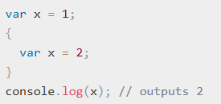
Block Statement - Examples
Here, { x++; } is the block statement
This outputs 2 because the var x statement within the block is in the same scope as the var x statement before the block. In C or Java, the equivalent code would have outputted 1.
Notes:
https://developer.mozilla.org/en-US/docs/Web/JavaScript/Guide/Control_flow_and_error_handling

Slide 60

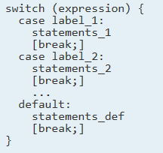
Conditional Statements
A conditional statement is a set of commands that executes if a specified condition is true.
JavaScript supports two conditional statements:
if...else : Use the if statement to execute a statement if a logical condition is true. Use the optional else clause to execute a statement if the condition is false.
and
switch : A switch statement allows a program to evaluate an expression and attempt to match the expression's value to a case label. If a match is found, the program executes the associated statement.
Notes:
https://developer.mozilla.org/en-US/docs/Web/JavaScript/Guide/Control_flow_and_error_handling

Slide 61
Conditionals if else (1)
JavaScript’s syntax is almost identical to that of PHP, Java, or C when it comes to conditional structures such as if and if else statements
In this syntax the condition to test is contained within ( ) brackets with the body contained in { } blocks
var hourOfDay;
var greeting;
if (hourOfDay > 4 && hourOfDay < 12) {
greeting = "Good Morning";
}
else if (hourOfDay >= 12 && hourOfDay < 18) {
greeting = "Good Afternoon";
}
else {
greeting = "Good Evening";
}
Notes:
https://developer.mozilla.org/en-US/docs/Web/JavaScript/Guide/Control_flow_and_error_handling

Slide 62
Conditionals if else (2)
In the case of multiple conditions only the first logical condition which evaluates to true will be executed.
To execute multiple statements, group them within a block statement ({ ... }) .
In general, it's good practice to always use block statements, especially when nesting if statements:
if (condition) {
statement_1_runs_if_condition_is_true;
statement_2_runs_if_condition_is_true;
} else {
statement_3_runs_if_condition_is_false;
statement_4_runs_if_condition_is_false;
}
Notes:
https://developer.mozilla.org/en-US/docs/Web/JavaScript/Guide/Control_flow_and_error_handling

Slide 63
Conditionals if else (3)
It is advisable to not use simple assignments in a conditional expression, because the assignment can be confused with equality when glancing over the code.
For example, do not use the following code:
if (x = y) {
/* statements here */
}
If you need to use an assignment in a conditional expression, a common practice is to put additional parentheses around the assignment.
For example:
if ((x = y)) {
/* statements here */
}
Notes:
https://developer.mozilla.org/en-US/docs/Web/JavaScript/Guide/Control_flow_and_error_handling

Slide 64
Falsy Values
The following values evaluate to false (also known as Falsy values):
false
undefined
null
0
NaN
the empty string ("")
All other values, including all objects, evaluate to true when passed to a conditional statement.
Do not confuse the primitive boolean values true and false with the true and false values of the Boolean object.

Slide 65
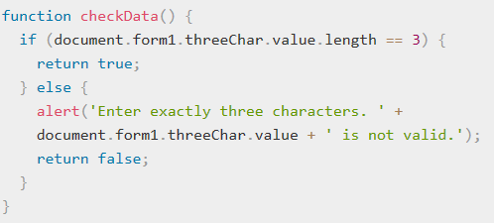
Falsy Values Example
In the following example, the function checkData returns true if the number of characters in a Text object is three; otherwise, it displays an alert and returns false.
If time permits, try doing this yourselves!

Slide 66
Class Exercise #7
Consider the following code:
var b = new Boolean(false);
if (b)
if (b == true)
What do the red expressions evaluate to?

Slide 67
Class Exercise #7 - Answer
var b = new Boolean(false);
if (b) // this condition evaluates to true
if (b == true) // this condition evaluates to false

Slide 68
Conditionals switch (1)
Another conditional statement is switch
The program first looks for a case clause with a label matching the value of expression and then transfers control to that clause, executing the associated statements. If no matching label is found, the program looks for the optional default clause, and if found, transfers control to that clause, executing the associated statements. If no default clause is found, the program continues execution at the statement following the end of switch. By convention, the default clause is the last clause, but it does not need to be so.
The optional break statement associated with each case clause ensures that the program breaks out of switch once the matched statement is executed and continues execution at the statement following switch. If break is omitted, the program continues execution at the next statement in the switch statement.
Its syntax is similar to other programming languages such as Java, PHP and C#
Notes:
https://developer.mozilla.org/en-US/docs/Web/JavaScript/Guide/Control_flow_and_error_handling

Slide 69
Conditionals switch (2)
Example:
switch (artType) {
case "PT":
output = "Painting";
break;
case "SC":
output = "Sculpture";
break;
default:
output = "Other";
}
Notes:
https://developer.mozilla.org/en-US/docs/Web/JavaScript/Guide/Control_flow_and_error_handling

Slide 70
Class Exercise #8
Write a switch statement that will:
if fruittype evaluates to one of the fruits in the list, it displays its price per kg (as table below)
When break is encountered, the program terminates switch and executes the statement following switch.
If break were omitted, the statement for case "Cherries" would also be executed.
Add appropriate messages where you deem fit.
Fruit | Prce per kg
Bananas | 0,99$
Oranges | 0,79$
Apples | 0,89$
Cherries | 2,99$
Grapes | 3,99$

Slide 71
Class Exercise #8 - Answer
switch (fruittype) {
case 'Oranges':
console.log('Oranges are $0.79 a kg');
break;
case 'Apples':
console.log('Apples are $0.89 a kg');
break;
case 'Bananas':
console.log('Bananas are $0.99 a kg.');
break;
case 'Cherries':
console.log('Cherries are $2,99 a kg..');
break;
case ‘Grapes':
console.log('Mangoes are $3.99 a pound.');
break;
default:
console.log('Sorry, we are out of ' + fruittype + '.');
}
console.log("Is there anything else you'd like?");
Fruit | Prce per kg
Bananas | 0,99$
Oranges | 0,79$
Apples | 0,89$
Cherries | 2,99$
Grapes | 3,99$

Slide 72
Exception handling statements
You can throw exceptions using the throw statement and handle them using the try...catch statements.
throw statement
try...catch statement
More on these statements in Part II of JavaScript

Slide 73
Conditional Assignment
/* x conditional assignment */
x = (y==4) ? “y is 4” : “y is not 4”;
/* equivalent to */
if (y==4) {
x = “y is 4”;
}
else {
x = “y is not 4”;
}
condition
value if true
value if false

Slide 74
Loops (1)
Like conditionals, loops use the ( ) and { } blocks to define the condition and the body of the loop
You will encounter the while and for loops
While loops normally initialize a loop control variable before the loop, use it in the condition, and modify it within the loop

Slide 75
Loops (2)
A loop as a computerized version of repeating an action some number of times (and it's actually possible that number could be zero). The statements for loops provided in JavaScript are:
for statement
do...while statement
while statement
labeled statement
break statement
continue statement
for...in statement
for...of statement
Notes:
https://developer.mozilla.org/en-US/docs/Web/JavaScript/Guide/Loops_and_iteration

Slide 76
for loop (1)
for loop repeats until a specified condition evaluates to false. The JavaScript for loop is similar to the Java and C for loop. A for statement looks as follows:
for ([initialExpression]; [condition]; [incrementExpression]) statement
A for loop combines the common components of a loop: initialization, condition, and post-loop operation into one statement
This statement begins with the for keyword and has the components placed between ( ) brackets, semicolon (;) separated as shown

Slide 77
for loop (2)
for ([initialExpression]; [condition]; [incrementExpression]) statement
When a for loop executes, the following occurs:
The initializing expression initialExpression, if any, is executed. This expression usually initializes one or more loop counters, but the syntax allows an expression of any degree of complexity. This expression can also declare variables.
The condition expression is evaluated. If the value of condition is true, the loop statements execute. If the value of condition is false, the for loop terminates. If the condition expression is omitted entirely, the condition is assumed to be true.
The statement executes. To execute multiple statements, use a block statement ({ ... }) to group those statements.
If present, the update expression incrementExpression is executed.
Control returns to step 2.

Slide 78
for loop - Example
The for statement counts the number of selected options in a scrolling list (a <select> element that allows multiple selections).
The for statement declares the variable i and initializes it to zero.
It checks that i is less than the number of options in the <select> element, performs the succeeding if statement, and increments i by one after each pass through the loop.
Notes:
https://developer.mozilla.org/en-US/docs/Web/JavaScript/Guide/Loops_and_iteration

Slide 79
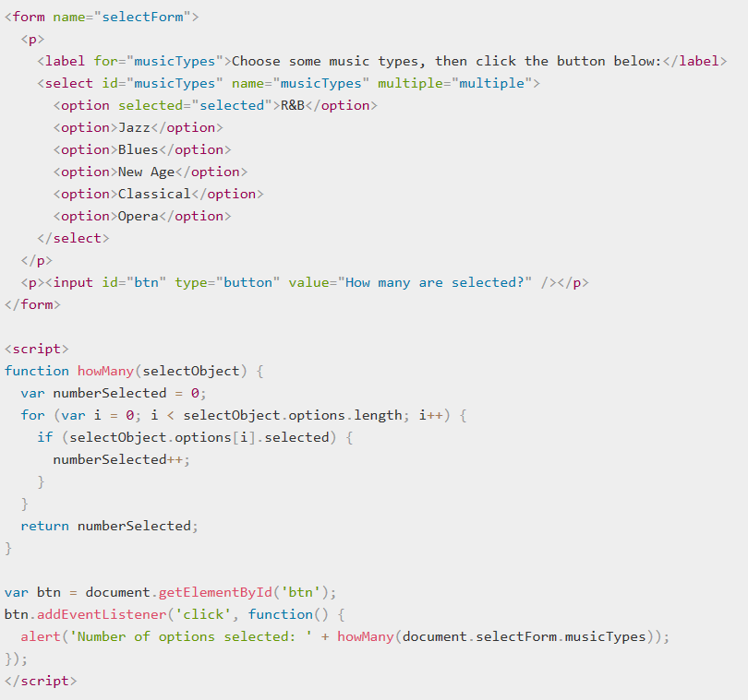
for loop - Example
Notes:
https://developer.mozilla.org/en-US/docs/Web/JavaScript/Guide/Loops_and_iteration

Slide 80
while statement
A while statement executes its statements as long as a specified condition evaluates to true. A while statement looks as follows:
while (condition)
statement
If the condition becomes false, statement within the loop stops executing and control passes to the statement following the loop.
The condition test occurs before statement in the loop is executed. If the condition returns true, statement is executed and the condition is tested again. If the condition returns false, execution stops and control is passed to the statement following while.
To execute multiple statements, use a block statement ({ ... }) to group those statements.

Slide 81
do…while statement (1)
The do...while statement repeats until a specified condition evaluates to false. A do...while statement looks as follows:
do
statement
while (condition);
statement executes once before the condition is checked. To execute multiple statements, use a block statement ({ ... }) to group those statements.
If condition is true, the statement executes again. At
the end of every execution, the condition is checked. When the condition is false, execution stops and control passes to the statement following do...while.

Slide 82
while/do while
var count = 0; //initialise the Loop Control Variable
while (count < 10) { //test the loop control variable
// do something
// ...
count++; //increment the loop control variable
}
count = 0; //initialise the Loop Control Variable
do {
// do something
// ...
count++; //increment the loop control variable
} while (count < 10); //test the loop control variable

Slide 83
Class Exercise#9
Write a do…while loop that iterates at least once, increases i by 1 each time and reiterates until I is no longer less than 7

Slide 84
Class Exercise#9 - Answer
Write a do…while loop that iterates at least once, increases i by 1 each time and reiterates until I is no longer less than 7
var i = 0;
do {
i += 1;
console.log(i);
} while (i < 7);

Slide 85
Arrays
Arrays are one of the most commonly used data structures in programming
JavaScript provides two main ways to define an array
object literal notation
use the Array() constructor

Slide 86
Arrays literal notation
The literal notation approach is generally preferred since it involves less typing, is more readable, and executes a little bit quicker
var years = [1855, 1648, 1420];
var countries = ["Canada", "France",
"Germany", "Nigeria",
"Thailand", "United States"];
var mess = [53, "Canada", true, 1420];

Slide 87
Arrays common features
arrays in JavaScript are zero indexed
[] notation for access
.length – gives the length of the array
.push() – inserts an item
.pop() – removes an item
concat(), slice(), join(), reverse(), shift(), and sort()

Slide 88
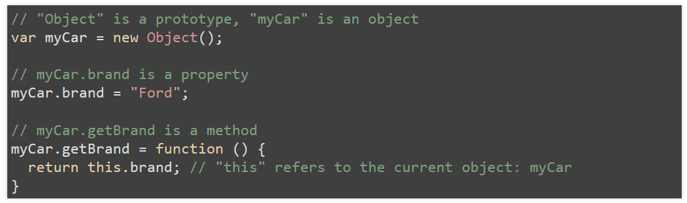
Objects in JavaScript
JavaScript is an object-based language based on prototypes instead of classes.
An object is a collection of properties, and a property is an association between a name (or key) and a value. A property's value can be a function, in which case the property is known as a method.
Notes:
https://developer.mozilla.org/en-US/docs/Web/JavaScript/Guide/Working_with_Objects

Slide 89
JavaScript Objects (1)
JavaScript is not a full-fledged object-oriented programming language
It does not have classes per se, and it does not support many of the patterns you’d expect from an object-oriented language like inheritance and polymorphism
The language does, however, support objects
Objects in JavaScript, just as in many other programming languages, can be compared to objects in real life.

Slide 90
JavaScript Objects (2)
An object is a standalone entity, with properties and type.
Compare it with a cup, for example. A cup is an object, with properties. A cup has a color, a design, weight, a material it is made of, etc. The same way, JavaScript objects can have properties, which define their characteristics.
Objects can have constructors, properties, and methods associated with them
There are objects that are included in the JavaScript language
You can also define your own kind of objects

Slide 91
Objects and Properties (1)
A JavaScript object has properties associated with it.
A property of an object can be explained as a variable that is attached to the object.
Object properties are basically the same as ordinary JavaScript variables, except for the attachment to objects. The properties of an object define the characteristics of the object.
You access the properties of an object with a simple dot-notation:
objectName.propertyName
Like all JavaScript variables, both the object name (which could be a normal variable) and property name are case sensitive. You can define a property by assigning it a value.

Slide 92
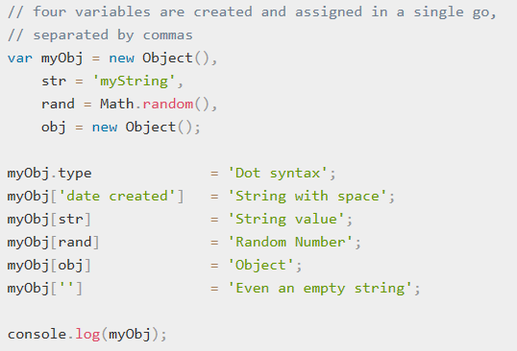
Objects and Properties (2)
An object property name can be any valid JavaScript string, or anything that can be converted to a string, including the empty string.
Any property name that is not a valid JavaScript identifier (for example, a property name that has a space or a hyphen, or that starts with a number) can only be accessed using the square bracket notation.
This notation is also very useful when property names are to be dynamically determined (when the property name is not determined until runtime).

Slide 93
Create New Objects
JavaScript has a number of predefined objects.
You can create your own objects.
Create objects through:
Using an object initializer.
First create a constructor function and then instantiate an object invoking that function in conjunction with the new operator.
Using the objects.create method

Slide 94
Object Creation (1)
var objName = {
name1: value1,
name2: value2,
// ...
nameN: valueN
};
Note: Unassigned properties of an object are undefined (and not null).

Slide 95
Object Creation (2)
// first create an empty object
var objName = new Object();
// then define properties for this object
objName.name1 = value1;
objName.name2 = value2;

Slide 96
Using object initializers
The syntax for an object using an object initializer is:
var obj = { property_1: value_1, // property_# may be an identifier...
2: value_2, // or a number...
// ...,
'property n': value_n }; // or a string
where obj is the name of the new object, each property_i is an identifier (either a name, a number, or a string literal), and each value_i is an expression whose value is assigned to the property_i.
The obj and assignment is optional; if you do not need to refer to this object elsewhere, you do not need to assign it to a variable. (Note that you may need to wrap the object literal in parentheses if the object appears where a statement is expected, so as not to have the literal be confused with a block statement.)

Slide 97

Examples
The following statement creates an object and assigns it to the variable x if and only if the expression cond is true:
The following example creates myHonda with three properties. Note that the engine property is also an object with its own properties.

Slide 98
Class Exercise #10
Create an object named myCar and give it properties named make, model, and year (use your favorite car)

Slide 99
Class Exercise #10 - Answer
Create an object named myCar and give it properties named make, model, and year (use your favorite car)
var myCar = new Object();
myCar.make = 'Ford';
myCar.model = 'Mustang';
myCar.year = 1969;

Slide 100
Create Object via Constructor
You can create an object with these two steps:
Define the object type by writing a constructor function. There is a strong convention, with good reason, to use a capital initial letter.
Create an instance of the object with new.
To define an object type, create a function for the object type that specifies its name, properties, and methods.

Slide 101
Constructors
Normally to create a new object we use the new keyword, the class name, and ( ) brackets with n optional parameters inside, comma delimited as follows:
var someObject = new ObjectName(p1,p2,..., pn);
For some classes, shortcut constructors are defined
var greeting = "Good Morning";
vs the formal:
var greeting = new String("Good Morning");

Slide 102
Class Exercise #10b
Suppose you want to create an object type for cars. You want this type of object to be called car, and you want it to have properties for make, model, and year. Use a constructor approach.

Slide 103
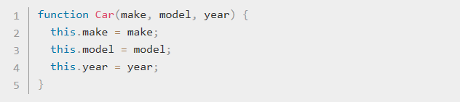

Class Exercise #10b - Answer
Create the function
Create an object my car
Create any number of car objects by calls to new

Slide 104
Properties
Each object might have properties that can be accessed, depending on its definition
When a property exists, it can be accessed using dot notation where a dot between the instance name and the property references that property
//show someObject.property to the user alert(someObject.property);

Slide 105
Enumerate the properties of an object
There are three native ways to list/traverse object properties:
for...in loops: This method traverses all enumerable properties of an object and its prototype chain
Object.keys(o) : This method returns an array with all the own (not in the prototype chain) enumerable properties' names ("keys") of an object o.
Object.getOwnPropertyNames(o) : This method returns an array containing all own properties' names (enumerable or not) of an object o.
Notes:
https://developer.mozilla.org/en-US/docs/Web/JavaScript/Guide/Working_with_Objects

Slide 106
Property enumeration example
function listAllProperties(o) {
var objectToInspect;
var result = [];
for(objectToInspect = o; objectToInspect !== null; objectToInspect = Object.getPrototypeOf(objectToInspect)) {
result = result.concat(Object.getOwnPropertyNames(objectToInspect));
}
return result;
}

Slide 107
Methods
Objects can also have methods, which are functions associated with an instance of an object
These methods are called using the same dot notation as for properties, but instead of accessing a variable, we are calling a method
someObject.doSomething();
Methods may produce different output depending on the object they are associated with because they can utilize the internal properties of the object

Slide 108
for loop (2)
When you want to browse objects you can use for in
var txt = “”;
var person = { fname: “John”, lname: “Doe”, age: 27 };
for (var x in person) {
txt +=person[x] + “ ” ;
}

Slide 109
Using the Object.create method
Objects can also be created using the Object.create() method.
This method can be very useful, because it allows you to choose the prototype object for the object you want to create, without having to define a constructor function

Slide 110
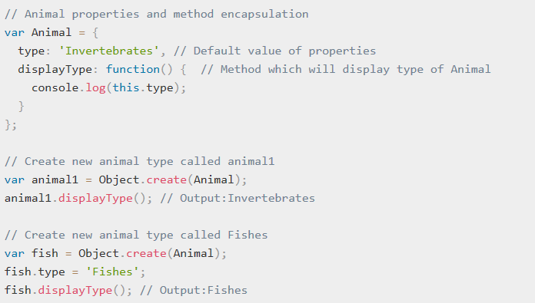
Object.create method Example

Slide 111
Objects Included in JavaScript
A number of useful objects are included with JavaScript including:
Array
Boolean
Date
Math
String
Dom objects

Slide 112
Math
The Math class allows one to access common mathematic functions and common values quickly in one place
This static class contains methods such as max(), min(), pow(), sqrt(), and exp(), and trigonometric functions such as sin(), cos(), and arctan()
Many mathematical constants are defined such as PI, E, SQRT2, and some others
Math.PI; // 3.141592657
Math.sqrt(4); // square root of 4 is 2.
Math.random(); // random number between 0 and 1

Slide 113
Date
The Date class is yet another helpful included object you should be aware of
It allows you to quickly calculate the current date or create date objects for particular dates
To display today’s date as a string, we would simply create a new object and use the toString() method
var d = new Date();
// This outputs Today is Mon Nov 12 2012 15:40:19 GMT-0700
alert ("Today is "+ d.toString());

Slide 114
Window
The window object in JavaScript corresponds to the browser itself
Through it, you can access the current page’s URL, the browser’s history, and what’s being displayed in the status bar, as well as opening new browser windows
In fact, the alert() function mentioned earlier is actually a method of the window object

Slide 115
References
https://developer.mozilla.org/en-US/docs/Learn/Getting_started_with_the_web/JavaScript_basics
https://www.w3schools.com/js/
https://javascript.info/
https://developer.mozilla.org/en-US/docs/Web/JavaScript/Guide/Grammar_and_types#Variables

Slide 116
Bibliography
Fundamentals of Web Development, 2nd Edition
Randy Connolly and Ricardo Hoar
ISBN 9780134481760
© 2018 Pearson

Slide 117
4.4 JavaScript (I)
Q&A
Exercises and Review Questions

Slide 118
Sample Question #1
Which of the following is an invalid name for a variable in JavaScript?
myvariable
function
integer3
_carpool

Slide 119
Sample Question #1 - Answer
Which of the following is an invalid name for a variable in JavaScript?
myvariable
function
integer3
_carpool

Slide 120
Sample Question #2
When you declare a variable outside of any function, it is called a_____________, because it is available to any other code in the current document.
constant
local variable
function
global variable

Slide 121
Sample Question #2 - Answer
When you declare a variable outside of any function, it is called a_____________, because it is available to any other code in the current document.
constant
local variable
function
global variable

Slide 122

Sample Question #3
What would be the outcome of this loop be?
Hello, world!
Null
Infinite loop
false

Slide 123
Sample Question #3 - Answer
What would be the outcome of this loop be?
Hello, world!
Null
Infinite loop
false

Slide 124
Class Review Exercise #1
You are provided with two variables:
A number: n
A boolean: isZero
If the value of n equals 0, then assign the value true to isZero.
If the value of n does not equal 0, then assign the value false to isZero.
Value of n = 5

Slide 125
CR Exercise #1 - Answer
var n =5;
if (n===0) {
isZero = true;
} else {
isZero=false;
}

Slide 126
Class Review Exercise #2
You are provided with a variable named counter and value 0
Create either a for or a while loop that will run 5 times and will increment the value of counter by 2 during each step.
The final value of counter should be 10.

Slide 127
CR Exercise #2 - Answer
var counter = 0;
do {
counter += 2;
console.log(i);
} while (counter<10);

Slide 128
Class Review Exercise #3
Using a switch statement write a function that returns 1 for 0 and 1 and the factorial of any number <=100

Slide 129
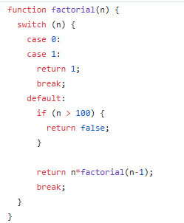
CR Exercise #3 - Answer
Notes:
https://gist.github.com/parisk/9186d3a23fa5700f71648c3cf8959bf1#file-exercise-8-js

Slide 130
Exercises
Exercise 1: What will the following expressions execution (evaluation) print?
2 + 3
“Hello ” + “World!”
“Hello ” + 1
“Hello”*5
“Hello”/2
10/0
Exercise 2: Write a function that takes as argument two strings, concatenates them and returns the result.

Slide 131
Exercises
Exercise 3: Create a car object of a Ferrari F430.
This should contain the following properties: Brand, Model, Max Speed (330 km/h), Current Speed, Status of whether the car has started or not.
User should be able to start, stop and set its speed status.
The car should also provide a way of exposing all the data described above, after each state change.
Exercise 4: Create a function that takes as argument the three constants (a, b, c) of a polynom and computes a second degree polynomial discriminant.
The type is (b*b) – (4*a*c).

Slide 132
Exercises
Exercise 3: Create a car object of a Ferrari F430.
This should contain the following properties: Brand, Model, Max Speed (330 km/h), Current Speed, Status of whether the car has started or not.
User should be able to start, stop and set its speed status.
The car should also provide a way of exposing all the data described above, after each state change.
Exercise 4: Create a function that takes as argument the three constants (a, b, c) of a polynom and computes a second degree polynomial discriminant.
The type is (b*b) – (4*a*c).

Slide 133
Thank you

Slide 135
JavaScript Part II
Notes:
https://developer.mozilla.org/en-US/docs/Web/JavaScript/Guide/Loops_and_iteration
http://coding-bootcamp.pkasid.com/exercises/javascript/3_control_flow_loops/
http://coding-bootcamp.pkasid.com/presentations/javascript

Slide 136
Contents
JavaScript Functions
Object Prototypes
Exception Handling
Document Object Model
JavaScript Events
JSON
XML Syntax and Validation
Data Validation

Slide 137
Learning Objectives
Understand the JavaScript functions and the different ways that they can be defined and called
Understand the object prototypes
Familiarize with the exception handling
Understand the Document Object Model and the selection process
Familiarize with the JavaScript events
Understand the JSON and XML model
Learn how to validate the form data

Slide 138
Functions (1)
A JavaScript function is a block of code designed to perform a particular task
This block can be reused within the code, and, if provided different arguments, can produce different results
Executed when "something“ invokes it (calls it – via an event call, direct call from code, or automatically)
A JavaScript function is defined with the function keyword, followed by a name, followed by parentheses ()

Slide 139
Functions (2)
Function names can contain letters, digits, underscores, and dollar signs - same rules as variables
In fact, functions can be used the same way as you use variables, in all types of formulas, assignments, and calculations
The parentheses may include parameter names separated by commas: (parameter1, parameter2, ...)
The code to be executed, by the function, is placed inside curly brackets: {}
Inside a function:
When JavaScript reaches a return statement, the function will stop executing.
If the function was invoked from a statement, JavaScript will "return" to execute the code after the invoking statement

Slide 140
Functions (3)
Functions are the building block for modular code in JavaScript
function subtotal(price,quantity) {
return price * quantity;
}
The above is formally called a function declaration, called or invoked by using the () operator
var result = subtotal(10,2);

Slide 141
Function Expressions
// defines a function using a function expression
var sub = function subtotal(price, quantity) {
return price * quantity;
};
// invokes the function
var result = sub(10,2);
It is conventional to leave out the function name in function expressions

Slide 142
Anonymous Function Expression
// defines a function using an anonymous function expression
var calculateSubtotal = function (price,quantity) {
return price * quantity;
};
// invokes the function
var result = calculateSubtotal(10,2);

Slide 143
Nested Functions
function calculateTotal(price,quantity) {
var subtotal = price * quantity;
return subtotal + calculateTax(subtotal);
// this function is nested
function calculateTax(subtotal) {
var taxRate = 0.05;
var tax = subtotal * taxRate;
return tax;
}
}

Slide 144
Callback Functions (1)
var calculateTotal = function (price, quantity, tax) {
var subtotal = price * quantity;
return subtotal + tax(subtotal);
};
var calcTax = function (subtotal) {
var taxRate = 0.05;
var tax subtotal * taxRate;
return tax;
};
var temp = calculateTotal(50,2,calcTax);
The local parameter variable tax is a
reference to the calcTax() function
Passing the calcTax() function
object as a parameter
We can say that calcTax variable
here is a callback function

Slide 145
Callback Functions (2)
In the previous example we can write the callback function inline
var temp = calculateTotal( 50, 2,
function (subtotal) {
var taxRate = 0.05;
var tax = subtotal * taxRate;
return tax;
}
);
Passing an anonymous function
as a callback function parameter

Slide 146
Objects and Functions Together
var order = {
salesDate : “May, 5, 2017”,
product : {
type: “laptop”,
price: 500.00,
output: function () {
return this.type + ‘ $’ + this.price;
}
},
customer : {
name: “Sue Smith”,
address: “123 Somewhere Str.”,
output: function () {
return this.name + ‘, ’ + this.address;
}
},
output: function () {
return ‘Date’ + this.salesDate;
}
};

Slide 147
Scope (1)
Scope determines the accessibility (visibility) of variables
In JavaScript there are two types of scope:
Local scope
Global scope
JavaScript has function scope
Each function creates a new scope
Variables defined inside a function are not accessible (visible) from outside the function
Since local variables are only recognized inside their functions, variables with the same name can be used in different functions
Local variables are created when a function starts, and deleted when the function is completed

Slide 148
Scope (2)
A variable declared outside a function, becomes GLOBAL
All scripts and functions on a web page can access it
In HTML, the global scope is the window object
If you assign a value to a variable that has not been declared, it will automatically become a GLOBAL variable
Do NOT create global variables unless you intend to
Your global variables (or functions) can overwrite window variables (or functions)
Any function, including the window object, can overwrite your global variables and functions

Slide 149
Scope (3)
// Function declaration
function myFunction() {
carName = “Volvo”;
var scopedCarName = “Saab”;
// Code here can use globalCarName and carName (as they are global)
// but also scopedCarName as local variable to myFunction
}
var globalCarName = “BMW”;
// Code her can use globalCarName as a global variable
// Code here can use carName as a global variable
// Code here can not use scopedCarName
// Function call
myFunction();

Slide 150
Object Prototypes
A prototype is an object from which other objects inherit properties
While the constructor function is simple to use, it can be an inefficient approach for objects that contain methods
Prototypes are an essential syntax mechanism in JavaScript, and are used to make JavaScript behave more like an object-oriented language and add functions to objects

Slide 151
Using Prototypes to Extend Other Objects
String.prototype.countChars = function (c) {
var count=0;
for (var i=0;i<this.length;i++) {
if (this.charAt(i) == c)
count++;
}
return count;
}
var msg = "Hello World";
console.log(msg + "has" + msg.countChars("l") + " letter l's");

Slide 152
Alert
The alert() function makes the browser show a pop-up to the user, with whatever is passed being the message displayed
The following JavaScript code displays a simple hello world message in a pop-up:
alert ( "Good Morning" );
Using alerts can get tedious fast
When using debugger tools in your browser you can write output to a log with:
console.log("Put Messages Here");
And then use the debugger to access those logs

Slide 153
Errors using try and catch
When the browser’s JavaScript engine encounters an error, it will throw an exception
These exceptions interrupt the regular, sequential execution of the program and can stop the JavaScript engine altogether
However, you can optionally catch these errors preventing disruption of the program using the try–catch block
try {
nonexistantfunction(“hello”);
}
catch(err) {
alert(“An exception was caught: ” + err);
}

Slide 154
Throw your own
Although try-catch can be used exclusively to catch built-in JavaScript errors, it can also be used by your programs, to throw your own messages
The throw keyword stops normal sequential execution, just like the built-in exceptions
try {
var x = -1;
if (x<0)
throw “smallerthanoError”;
}
catch(err) {
alert(err + “was thrown”);
}

Slide 155
Document Object Model
JavaScript is almost always used to interact with the HTML document in which it is contained
This is accomplished through a programming interface (API) called the Document Object Model
According to the W3C, the DOM is a:
Platform- and language-neutral interface that will allow programs and scripts to dynamically access and update the content, structure and style of documents.

Slide 156
DOM Overview

Slide 157
DOM Nodes
In the DOM, each element within the HTML document is called a node. If the DOM is a tree, then each node is an individual branch
There are:
element nodes,
text nodes, and
attribute nodes
All nodes in the DOM share a common set of properties and methods

Slide 158
Element Node Object
Element Node object represents an HTML element in the hierarchy, contained between the opening <> and closing </> tags for this element
Every node has
classList
className
Id
innerHTML
Style
tagName

Slide 159
Essential Node Object properties
Property | Description
attributes | Collection of node attributes
childNodes | A NodeList of child nodes for this node
firstChild | First child node of this node
lastChild | Last child of this node
nextSibling | Next sibling node for this node
nodeName | Name of the node
nodeType | Type of the node
nodeValue | Value of the node
parentNode | Parent node for this node
previousSibling | Previous sibling node for this node

Slide 160
Other Common Attributes
href
name
src
value
However these do not exist in all objects

Slide 161
Document Object
The DOM document object is the root JavaScript object representing the entire HTML document
// retrieve the URL of the current page
var a = document.URL;
// retrieve the page encoding, for example ISO-8859-1
var b = document.inputEncoding;

Slide 162
Selection Methods (1)
Classic
getElementById()
getElementsByTagName()
getElementsByClassName()
Newer
querySelector() and
querySelectorAll()

Slide 163
Selection Methods (2)
var node = document.getElemtById(“latest”);
<body>
<h1>Reviews</h1>
<div id=“latest”>
<p>By Ricardo on <time>2016-05-23</time></p>
<p class=“comment”>Easy on the HDR buddy.</p>
</div>
<hr/>
<div>
<p>By Susan on <time>2016-11-18</time></p>
<p class=“comment”>I love Central Park.</p>
</div>
<hr/>
</body>
var list2 = document.getElementByClassName(“comment”);
var list1 = document.getElementByTagName(“div”);

Slide 164
Query Selectors
querySelector(‘#latest’)
querySelectorAll(‘div time’)
<body>
<h1>Reviews</h1>
<div id=“latest”>
<p>By Ricardo on <time>2016-05-23</time></p>
<p class=“comment”>Easy on the HDR buddy.</p>
</div>
<hr/>
<div>
<p>By Susan on <time>2016-11-18</time></p>
<p class=“comment”>I love Central Park.</p>
</div>
<hr/>
</body>

Slide 165
JavaScript Events
JavaScript event is an action that can be detected by JavaScript
many of them are initiated by user actions
some are generated by the browser itself
We say that an event is triggered and then it is handled by JavaScript functions

Slide 166
Event-Handling Approaches (1)
Inline Hook
…
<script type=“text/javascript” src=“inline.js”></script>
…
<form name=‘mainform’ onsubmit=“validate(this);”>
<input name=“name” type=“text”
onchange=“check(this);”
onfocus=“highlight(this, true);”
onblur=“highlight(this, false);”>
…
inline.js
function validate(node) {
…
}
function check(node) {
…
}
function highlight(node, state) {
…
}

Slide 167
Event-Handling Approaches (2)
Event Property Approach
var myButton = document.getElementById('example');
myButton.onclick = alert('some message');

Slide 168
Event-Handling Approaches (3)
Event Listener Approach
var myButton = document.getElementById('example');
myButton.addEventListener('click', alert('some message'));
myButton.addEventListener('mouseout', funcName);

Slide 169
Event-Handling Approaches (4)
Event Listener Approach (anonymous function)
myButton.addEventListener('click', function() {
var d = new Date();
alert("You clicked this on "+ d.toString());
});

Slide 170
Event Object (1)
When an event is triggered, the browser will construct an event object that contains information about the event.
div.addEventListener('click', function(e) {
// find out where the user clicked
var x = e.clientX;
…

Slide 171
Event Object (2)
bubbles
Indicates whether the event bubbles up through the DOM
cancelable
Indicates whether the event can be cancelled
target
The object that generated (or dispatched) the event
type
The type of the event

Slide 172
Mouse Event Types
click
The mouse was clicked on an element
dblclick
The mouse was double clicked on an element
mousedown
The mouse was pressed down over an element
mouseup
The mouse was released over an element
mouseover
The mouse was moved (not clicked) over an element
mouseout
The mouse was moved off of an element
mousemove
The mouse was moved while over an element

Slide 173
Click Event Types
keydown
The user is pressing a key (this happens first)
keypress
The user presses a key (this happens after keydown)
keyup
The user releases a key that was down (this happens last)

Slide 174
Touch Event Types
Touch events are a new category of events that can be triggered by devices with touch screens
There is limited Browser support (in 2017)
The different events (e.g., touchstart, touchmove, and touchend) are analogous to some of the mouse events (mousedown, mousemove, and mouseup)

Slide 175
Form Event Types
blur
When an element has lost focus
change
When a value in an element has changed by the user
focus
When an element has received focus
reset
When a form is reset
select
When some text is being selected
submit
When the form is submitted

Slide 176
Frame Event Types
abort
An object was stopped from loading
error
An object or image did not properly load
load
When a document or object has been loaded
resize
The document view was resized
scroll
The document view was scrolled
unload
The document has unloaded

Slide 177
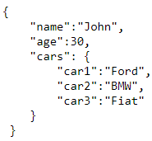
JSON (1)
JSON: JavaScript Object Notation
JSON is a syntax for storing and exchanging data
JSON is text, written with JavaScript object notation
When exchanging data between a browser and a server, the data can only be text
We can convert any JavaScript object into JSON, and send JSON to the server, also convert any JSON received from the server into JavaScript objects
This way we can work with the data as JavaScript objects, with no complicated parsing and translations
JSON syntax is a subset of the JavaScript syntax

Slide 178
JSON (2)
JSON data is written as name/value pairs
Keys (names) must be strings, written with double quotes
Values must be one of the following data types: string, number, object (JSON object), array, boolean, null
In JavaScript, keys can be strings, numbers, or identifier names
In JavaScript values can be all of the above, plus any other valid JavaScript expression, including function, date and undefined
The file type for JSON files is ".json"
The MIME type for JSON text is "application/json“
Both JSON and XML can be used to receive data from a web server

Slide 179
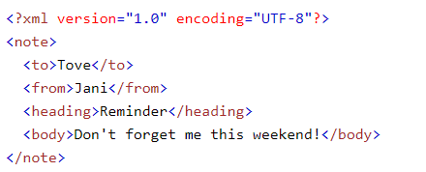
XML
XML stands for eXtensible Markup Language.
Designed to store and transport data.
Designed to be both human- and machine-readable.
Does not carry any information about how to be displayed.
Used in many aspects of web development.
Used to separate data from presentation.
XML documents form a tree structure that starts at "the root" and branches to "the leaves".

Slide 180
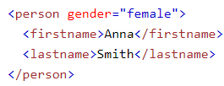
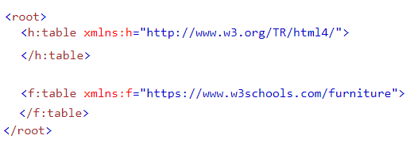
XML Syntax Rules
XML can contain the prolog line, that often defines XML document version and encoding.
XML documents must contain one root element that is the parent of all other elements.
All XML Elements Must Have a Closing Tag
XML Elements Must be Properly Nested
XML Tags are Case Sensitive
XML elements can have attributes, just like HTML.
Attributes are designed to contain data related to a specific element.
XML Namespaces provide a method to avoid element name conflicts.

Slide 181
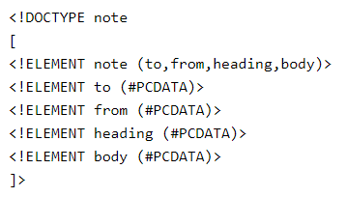
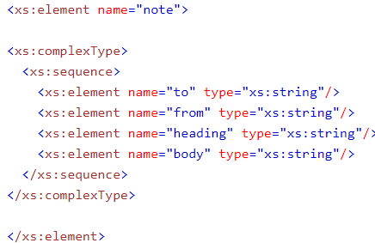
XML Validation
An XML document with correct syntax is called "Well Formed".
An XML document validated against a DTD is both "Well Formed" and "Valid".
The purpose of a DTD is to define the structure of an XML document.
It defines the structure with a list of legal elements.
An XML Schema (XSD) describes the structure of an XML document, just like a DTD.
XML Schema is an XML-based alternative to DTD.

Slide 182
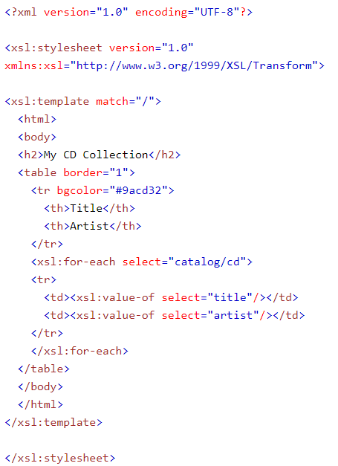
XML: XSLT
XSL (eXtensible Stylesheet Language) is a styling language for XML.
XSLT stands for XSL Transformations
XSLT is the most important part of XSL
XSLT transforms an XML document into another XML document
XSLT uses XPath to navigate in XML documents
XSLT is a W3C Recommendation
An XSL style sheet consists of one or more set of rules that are called templates.
A template contains rules to apply when a specified node is matched.

Slide 183
Data Validation (1)
Data validation is the process of ensuring that user input is clean, correct, and useful. Typical cases:
has the user filled in all required fields?
has the user entered a valid date?
has the user entered text in a numeric field?
Data validation can occur on both the Server and the Client.
Server side validation is performed by a web server, after input has been sent to the server.
Client side validation is performed by a web browser, before input is sent to a web server.
NOTE: both validations should take place, for security purposes.

Slide 184
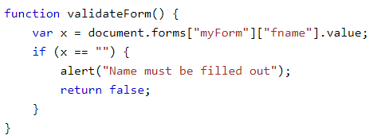
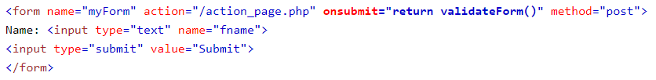
Data Validation (2)
In many cases, data are sent to the server via HTML Forms.
However, validation cam be crucial on data.
Validation can (and should) occur both on the server and the client.
HTML form validation can be done by JavaScript
JavaScript Can Validate Text Input
JavaScript Can Validate Numeric Input
HTML form validation can also be performed automatically by the browser
If a form field is empty, the required attribute prevents this form from being submitted:

Slide 185
References
https://www.w3schools.com/js/
https://www.w3schools.com/xml/default.asp
https://www.w3schools.com/xml/xsl_intro.asp

